Slide 1
Mrs. Almonte
Science class

Slide 2
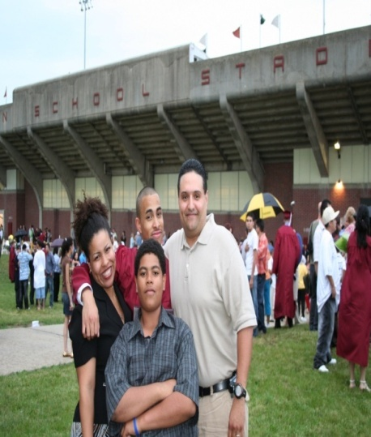
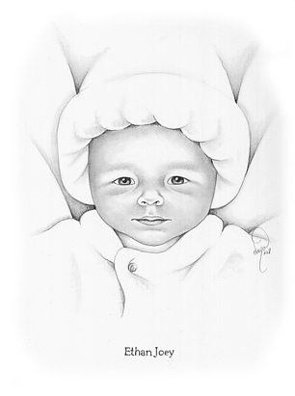
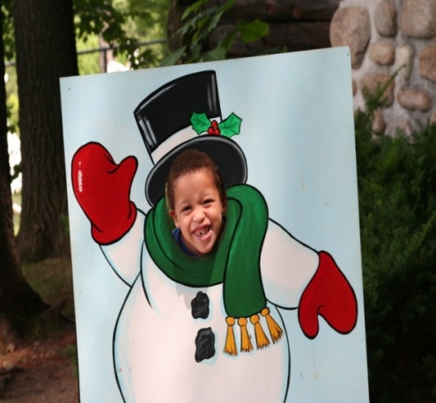
About Me
A proud wife
A proud mother of four boys
Enjoy reading and learning new things
Enjoy talking with friends
Enjoy attending church and teaching Bible lessons
Love spending time with my family
Enjoy jogging and walking
Have three fish and two silly cats

Slide 3
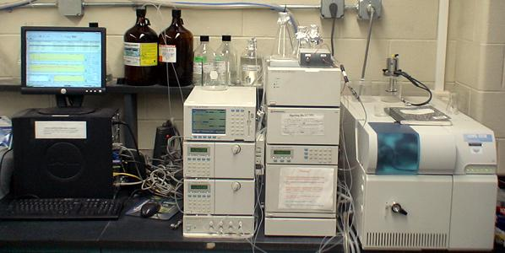
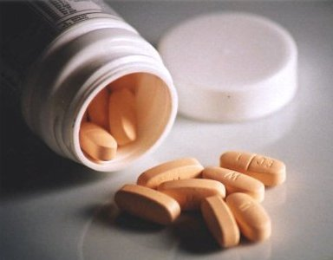
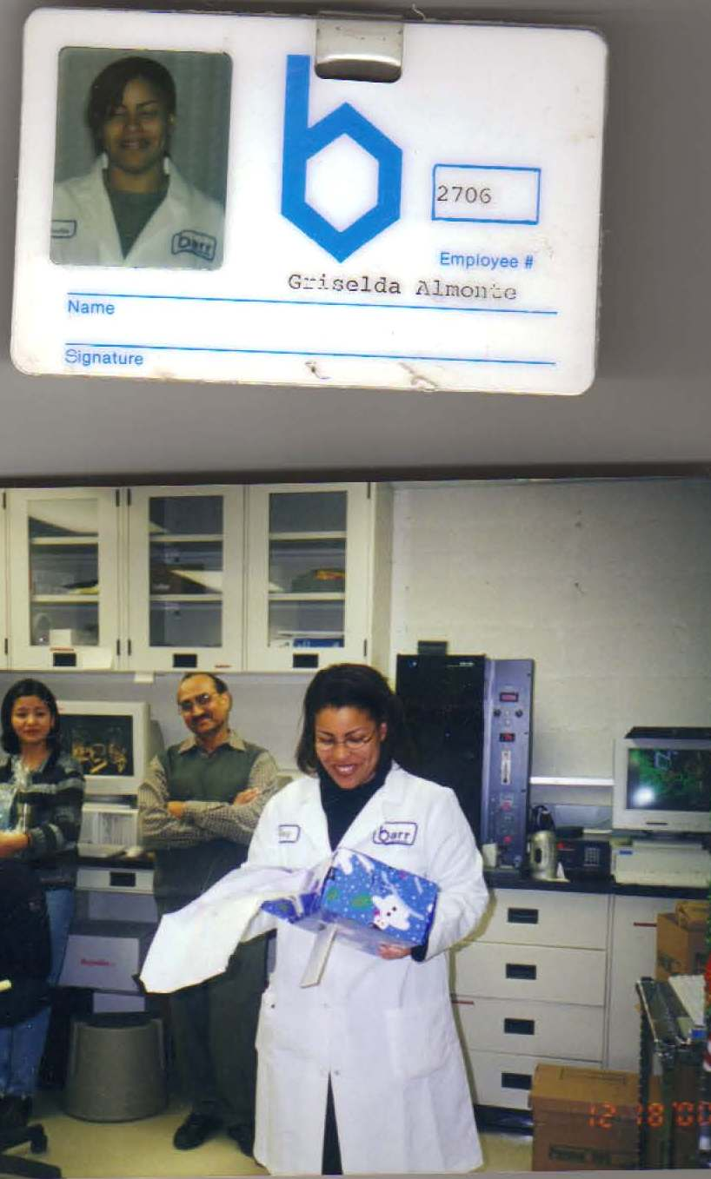
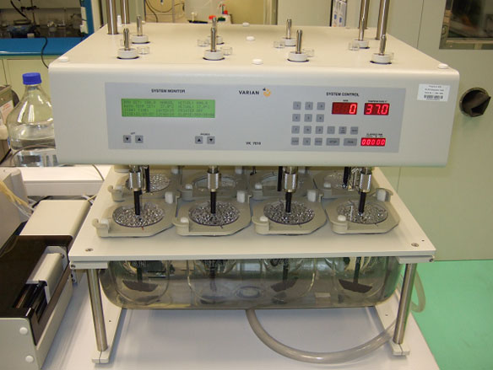

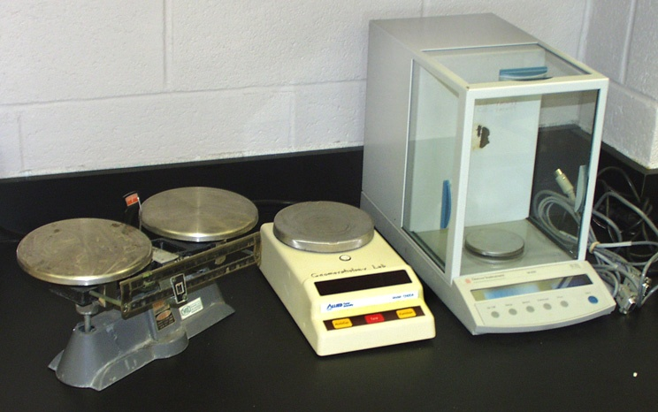
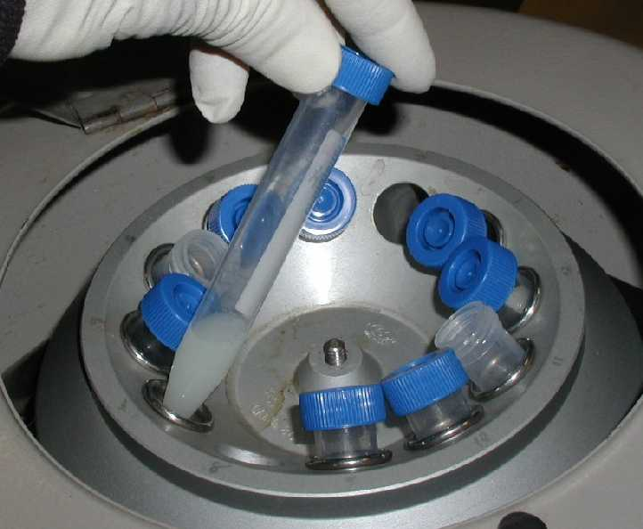
Before I became a teacher . . .
I was a pharmaceutical Chemist

Slide 4
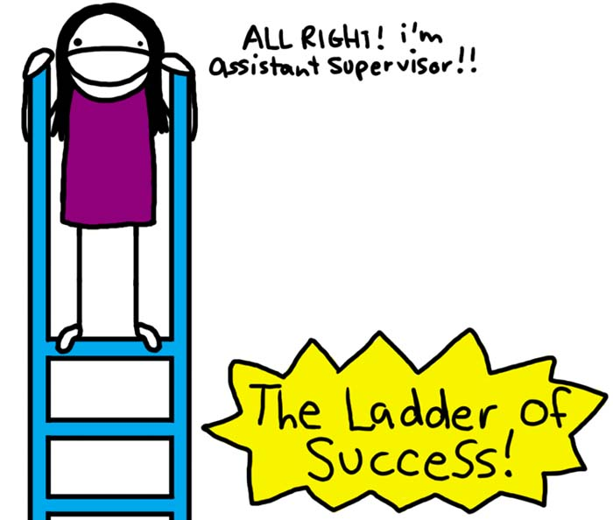
Don’t You Want to Be Successful?

Slide 5

What Is Our Class Goal?
To turn all of our procedures into routines.
To have a safe and fun learning environment.

Slide 6
Mrs. Almonte’s Classroom Guidelines

Slide 7
Classroom Rules
Ask before getting out of your seat
Be quiet when others speak
Keep your hands and items to yourself
No profanity

Slide 8


Consequences
1st Time = Name on the board (Warning)
2nd Time =
  15 minutes after school
  Call home
3rd Time =
  No Parent No School Form
  Meeting with teacher, student, and guardian
4th Time =
  Referred to principal for ISS or suspension
Note: Names will be erased from the board every Friday at 3pm

Slide 9

Rewards
Individual Rewards
Class Rewards*
A student who goes beyond what is expected in the classroom
(behavior, helps another student, class work, etc.)
Choose from the gift box
10 extra credit points coupon to be applied to tests and quizzes
15 minutes free computer time coupon
The class that consistently shows respect to each other and has 100% homework participation for the month
In class movie
Choose science topic for the day
Donuts
*Class reward will be chosen by the teacher*

Slide 10
Mrs. Almonte’s Classroom Procedures

Slide 11
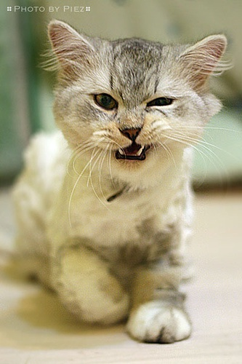
What More Rules???!!!!!!
Rules
Tells you what is expected of you and have consequences when broken
What is a procedure?
A procedure tells you how to do something step by step until it becomes a routine
What is a routine?
A routine is doing something everyday on your own without me telling you to do so

Slide 12
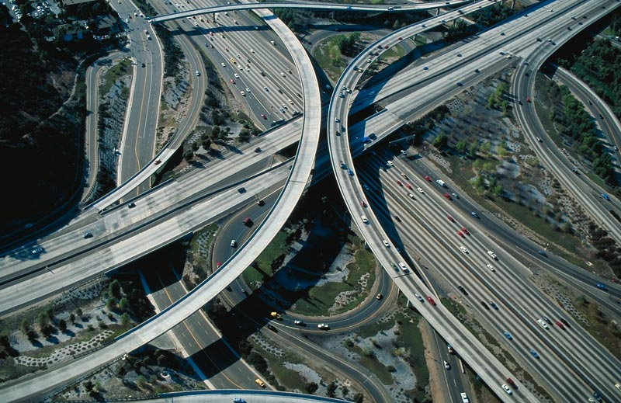

Example of a Familiar Procedure
What do drivers do at a red light?
What do drivers do at a green light?
How do they know which side of the road to
drive on?
What will happen if we had no procedures for driving on the highway/streets?

Slide 13

Why Have Procedures?
Everyone will know exactly what to do
Gives us more learning time
Keeps our environment safe
Helps you become a successful student

Slide 14
Entering the Classroom
DO NOT enter the classroom if a
teacher is not present
Wait quietly in the hallway until I come
to greet you at the door
Keep the noise level down when
entering the classroom

Slide 15
As Soon As You Enter Class
  A “Do Now” assignment will be posted
  Do not start socializing
  Begin assignment right away

Slide 16
Excused Late
Fill out late form
Place both late form and your late pass in the
late folder
Begin Do Now assignment

Slide 17
Unexcused Late
Fill out late form and check off your excuse
Consequences:
1. Verbal warning
2. 10 minutes after school minimum
3. ISS recommendation

Slide 18

Finish Class Work Early
Complete any work you owe me
Take out a science reading novel from the bin
Complete your NJASK workbook assignments

Slide 19

During Class Discussions
Do Not . . .
  Ask can I throw something out
  Ask can I go to the bathroom (unless it’s an emergency)
  Interrupt the speaker
Do . . .
Raise your hand
Be a good listener
Wait patiently for your
turn

Slide 20



Classroom Signals
Question/Need help
I understand the topic
Bathroom
I don’t understand the topic
I understand the topic a little…

Slide 21


Pencil Sharpening
Lift up your pencil
Wait for my signal
Exchange your pencil for a sharpened one

Slide 22
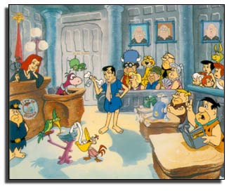
Classroom Interruptions
(Ex: phone call or visitor)
Wait silently until I am available
Continue doing your work
If you are working in a group,
keep the noise down

Slide 23
Independent Work
You will always have the
option to work alone
Work in groups
  Ask your team members for help first
Work with a teacher
Whatever you choose you must do it quietly without distracting the learning environment

Slide 24
End of Class Dismissal
Verify that you wrote your homework
Verify that you have all your materials
Clean up your space (desk & floor)
Wait quietly until I dismiss you even if
the bell rings

Slide 25
If You Are Absent
Check the “absent bin”
You have two days for each day you missed to
complete work
Example:
I was absent on May 4 & 5. I returned to school on May 6. I have two days worth of work to make up. I have four days to turn in my work. My work is due May 10.

Slide 26
Student Responsibility Sheet
Choose all that applies to you: I did not bring in my . . .
text book
pencil/pen
notebook
assigned homework
Choose all that applies to you: I did not bring in my__________because
I did not have the materials at home to complete my assignment
I forgot
I was too sick to do my homework
I was absent and did not get the assignment
Other-Please explain in detail: __________________________________________________________________________________________________________________________________________________________________________________________________________________________________________________________________________________________________________________________________________________
Your Signature_________________________________
Today’s Date____________________________________
PLEASE READ: You will lose 2 points off your overall grade for each Responsibility Sheet you hand in. *This sheet will be put in your test folder for parents to see during Conference Night*

Slide 27
Teacher-Student Contract
Date_________________
Student
I _____________ will follow of all my classroom procedures to the best of my ability. I will also follow our school policies. I will do my best to come prepared to class and give my teacher my attention 100% so that I could learn new ideas and equip myself with the knowledge I need to be a productive person in society.
I will be honest and respectful to my teacher and peers. I will always put my best effort in all my classes.
Student Signature
____________________________________
Teacher
I_______________________________ will teach you to the best of my abilities and will be sensitive to your needs. I will give you ample time to complete your assignments. I will be honest with you and give you my attention 100%.
Teacher Signature
_____________________________________
Parent Signature
_______________________________________

Slide 28

My Promise to You
I will listen to you
I will respect you
I will teach you to the best of my abilities

Slide 29
Closing Thoughts
I believe you ALL can be successful
I care for you
I am interested in helping you become life long learners
If you don’t love Science—you will!!!

